Slide 1

FUTURECART-AI DRIVEN DEMAND PREDICTION
By,
Chris Joy

Slide 2


CONTENTS
INTRODUCTION | 3
PROBLEM STATEMENT | 4
OBJECTIVES | 5
METHODOLOGY | 6
DATA SOURCES AND WORKFLOW | 7
DATA PREPROCESSING | 8
DATA MERGING | 9
EDA | 10
TIMESERIES MODELLING | 11
EVALUATION METRICS,INSIGHTS AND CONCLUSIONS | 14
MULTIVARIATE REGRESSION WITH VISUALIZATION | 15
FORECASTING USING SARIMAX MODEL | 16

Slide 3

INTRODUCTION
In the fast-paced retail sector, it is very critical to predict customer demand; however, traditional forecasting models are not able to understand the complexity of modern shopping behaviors influenced by digital engagement and seasonal trends. The project uses AI-powered time series analysis and multivariate regression to combine historical sales data with online activity metrics, including clicks and impressions. It allows integrating disparate data sources and hence permits businesses to optimize inventory, tailor marketing, and thus enhance customer satisfaction. Such a solution yields a really powerful, data-driven approach that helps retailers to thrive in the highly competitive arena of the marketplace.
Drag and drop your photo or video! Click the sample photo or video and delete. Select yours from the uploads tab, drag, and then drop inside the frame!

Slide 4
PROBLEM STATEMENT
The unpredictable sales patterns and external influences in the ever-evolving e-commerce landscape make it challenging for businesses to manage inventory, optimize marketing strategies, and meet customer expectations. This project introduces an AI-powered demand forecasting model that integrates historical sales data with external metrics such as Google clicks and Facebook impressions. This allows the model to provide efficient inventory management, smarter marketing decisions, and data-driven strategies to effectively anticipate and meet customer demand, thus enabling businesses to succeed in a competitive market.

Slide 5
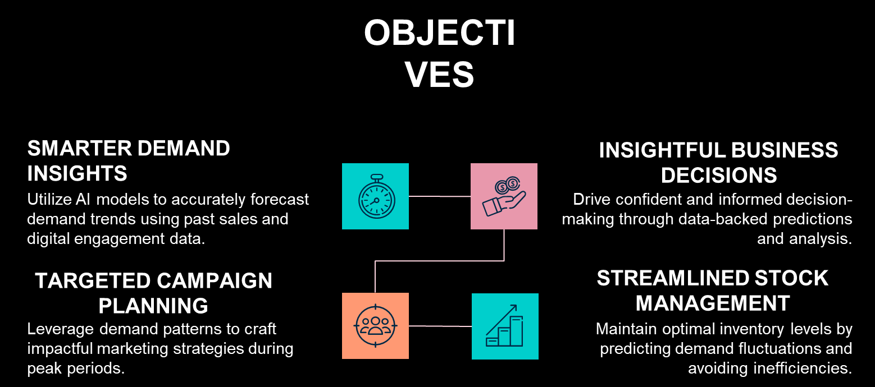
OBJECTIVES

Slide 6
METHODOLOGY
1
2
3
4
5
Data Collection
EDA and Data Processing
Timeseries Modelling
Multivariate Regression
Model Evaluation,Selection & Forecasting

Slide 7
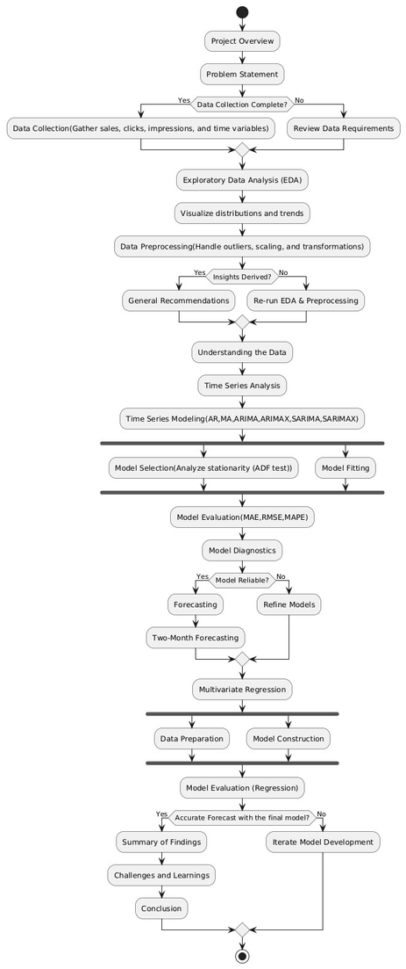
DATA SOURCES AND WORKFLOW
Data Description:The dataset used includes historical sales data (target variable: Quantity) and external factors such as Clicks and Impressions (from Google Analytics and social media).
Data Structure: Quantity (sales data) has been assigned as Target Variable while Clicks, Impressions have been assigned as Exogenous Variables since these are the external factors that have influence over demand of the product.
Data Quality: Challenges included handling missing values and data cleaning.

Slide 8
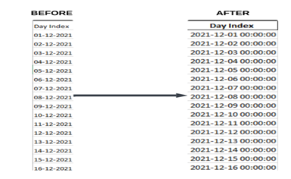
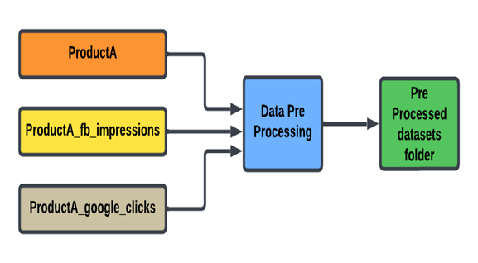
DATA PRE PROCESSING
STEP 1: Convert the 'Day Index' column to a proper datetime format
Converting the 'Day Index' column to a proper datetime format ensures consistency, accuracy, and compatibility with date-based operations. It allows for easier analysis, time-based aggregations, and smooth data merging or filtering, while preventing errors or mismatches due to incorrect date formats
STEP 2: Remove duplicate rows
There were no duplicate rows in the dataset, so this step was not necessary.
STEP 3: Fill any missing values using forward fill
There were no missing values in the dataset, so this step was not needed.
FINAL STEP :Output Data
Cleaned datasets are saved into the pre_processed_datasets folder, ready for merging.

Slide 9
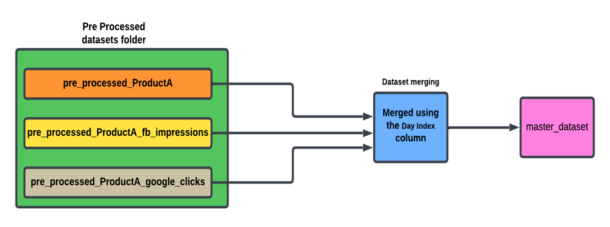
DATA MERGING
The process involves loading preprocessed datasets from the pre_processed_datasets folder, merging them based on the common column Day Index, and saving the final merged dataset to the master_dataset folder.

Slide 10
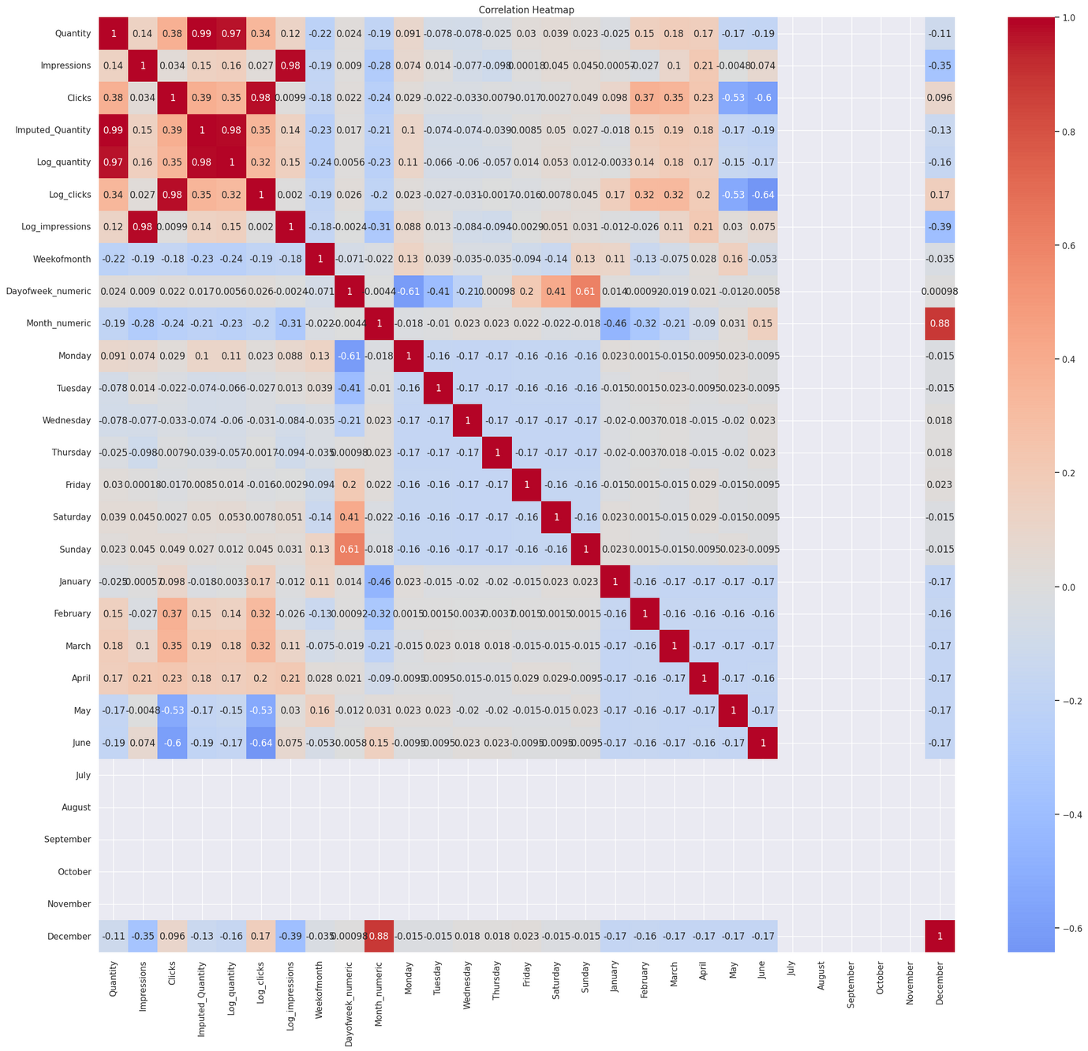
EXPLORATORY DATA ANALYSIS
Conducted a comprehensive analysis to uncover patterns and trends. 
Visualized sales data, clicks, and impressions to identify: >Seasonal trends (e.g., holiday spikes).
>Correlations between clicks and impressioans with sales demand. >Anomalies, such as outliers linked to specific campaigns or promotions. 
Tools used: matplotlib and seaborn for detailed visualizations.

Slide 11
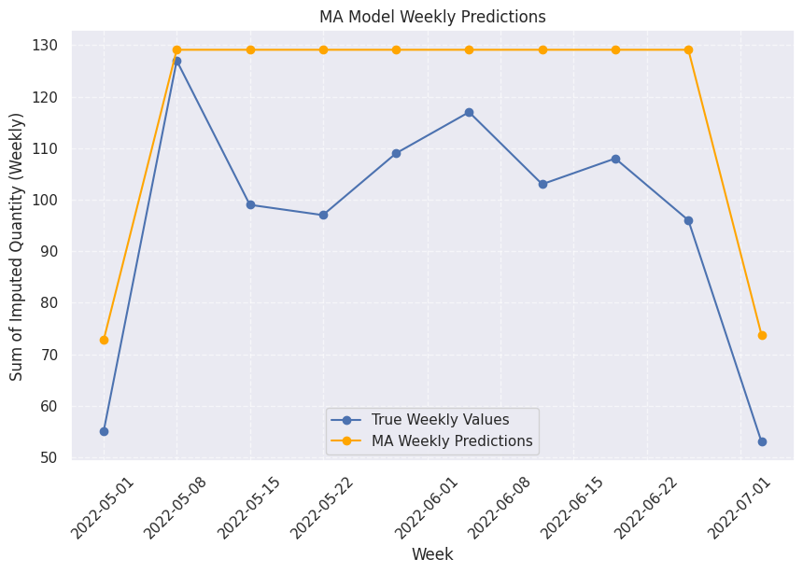
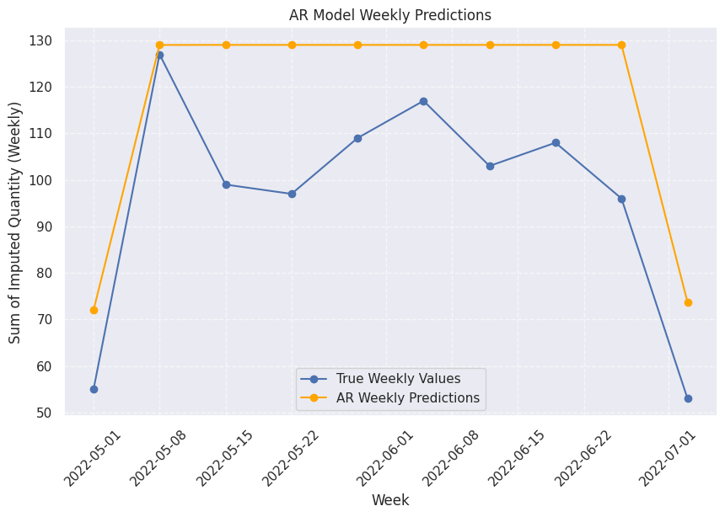
TIMESERIES MODELLING
AR MODEL
MA MODEL
●Predicts future values based on a linear combination of its past values.
●Models the error terms (residuals) from past predictions rather than the actual values.

Slide 12
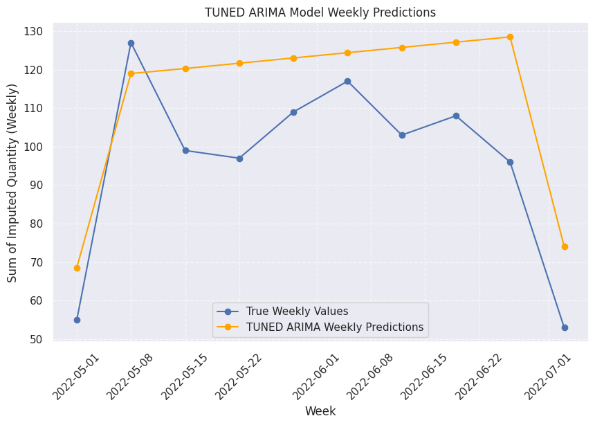
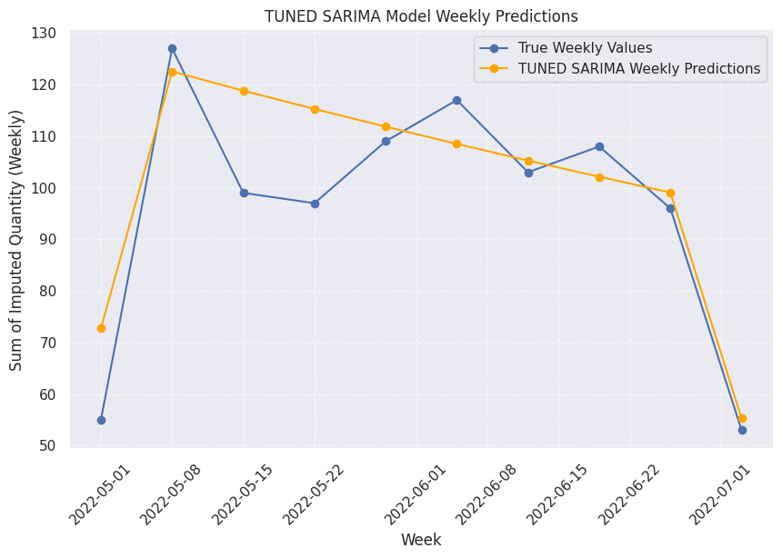
TIMESERIES MODELLING
ARIMA MODEL
SARIMA MODEL
Combines AR and MA techniques, adding a differencing step to handle non-stationary data.
Extends ARIMA by incorporating seasonal components to address repeating patterns over fixed intervals.

Slide 13
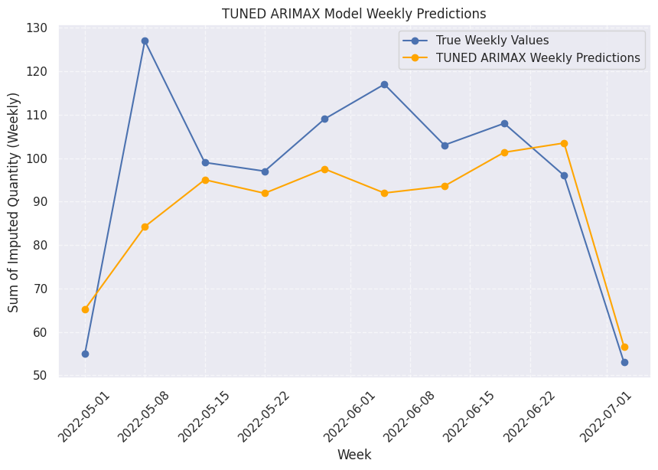
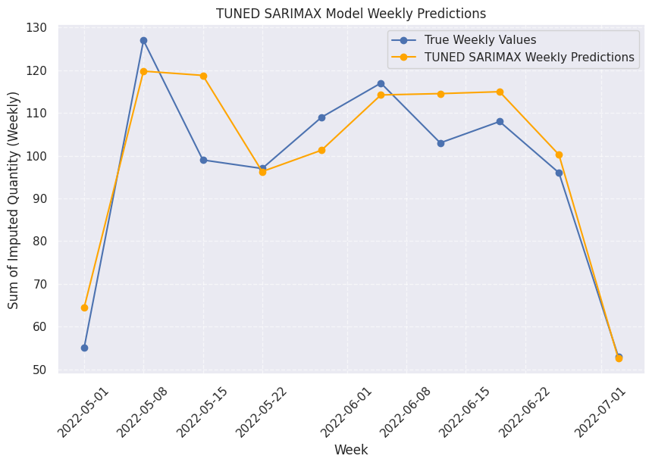
TIMESERIES MODELLING
ARIMAX MODEL
SARIMAX MODEL
Enhances ARIMA by including external predictors (e.g., clicks, impressions) to improve accuracy.
Combines the seasonal capabilities of SARIMA with the flexibility of external inputs.

Slide 14
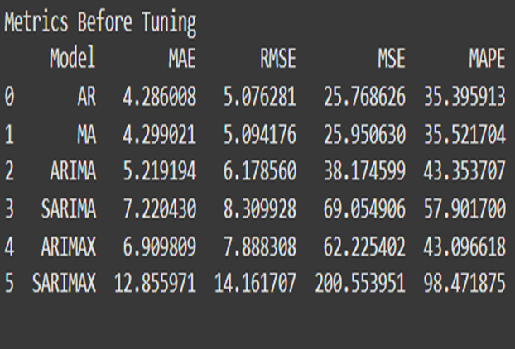
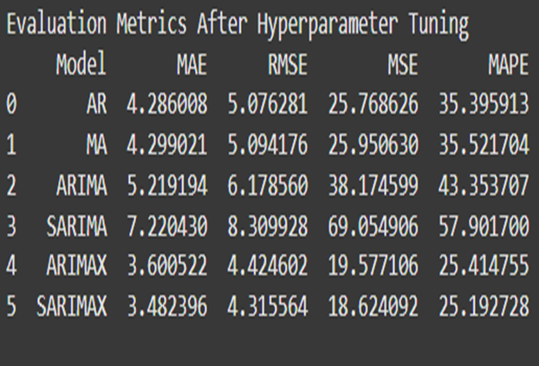
EVALUATION METRICS,INSIGHTS & CONCLUSIONS
Superior Accuracy: Compared to simpler models (AR, MA), SARIMAX consistently showed higher accuracy and a more comprehensive data understanding.
Conclusion: SARIMAX meets the project’s forecasting needs, making it the recommended approach for reliable time series analysis and demand prediction

Slide 15
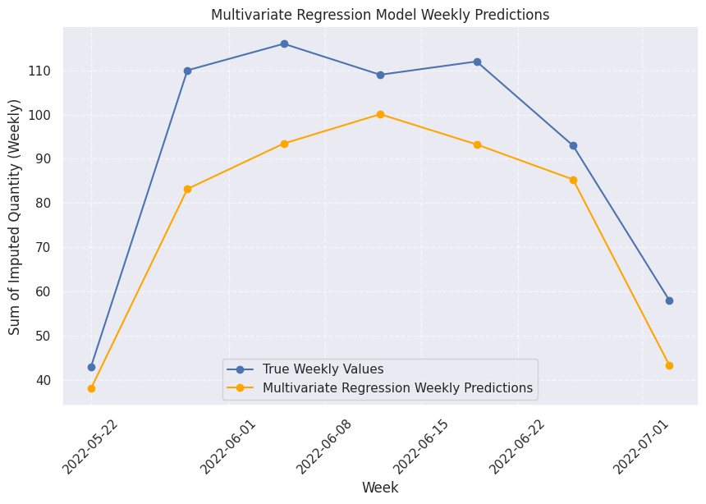
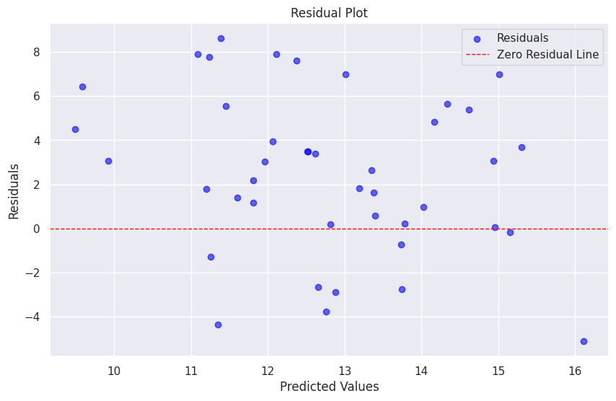
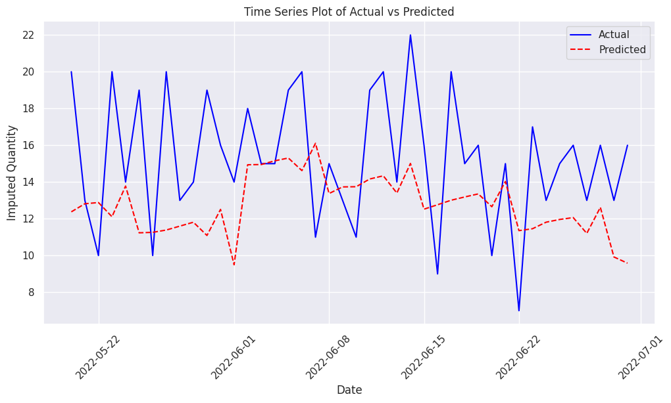
MULTIVARIATE REGRESSION WITH VISUALIZATION
The multivariate regression model was used to predict daily values based on the tuned parameters. Key Insight: The model captures daily fluctuations but struggles with significant spikes, leading to slight discrepancies between predicted and actual values. Residuals, calculated as the difference between actual and predicted values, were analyzed to assess the model's performance. The residuals plot revealed minimal systematic errors and demonstrated randomness, indicating no significant biases.

Slide 16
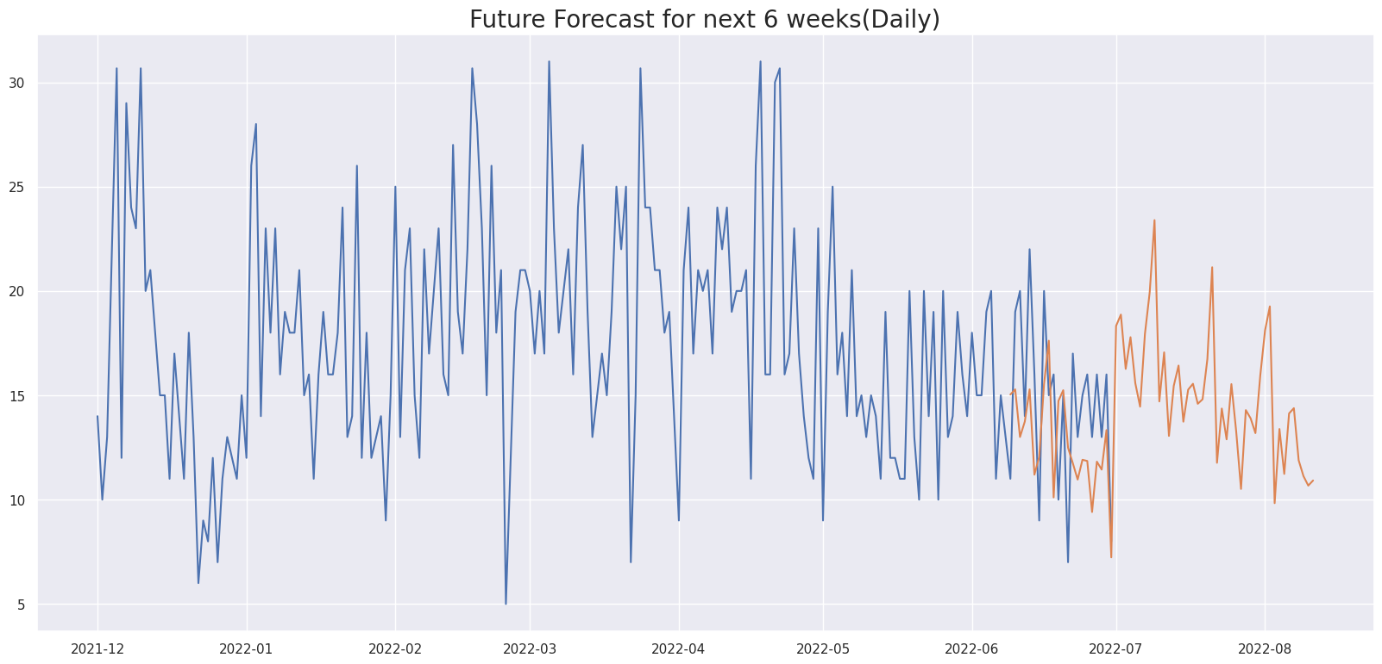
FORECASTING USING SARIMAX MODEL
Plotted the forecast for 6 weeks on a daily as well as weekly basis using the SARIMAX timeseries model with the parameters: {'p': 2, 'd': 0, 'q': 2, 'P': 0, 'D': 1, 'Q': 1}.

Slide 17
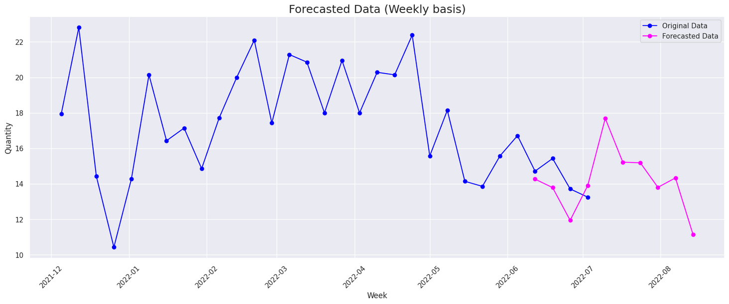
FORECASTING USING SARIMAX MODEL
SARIMAX MODEL PREDICTIONS CAPTURED SEASONALITY AS WELL AS GENERALIZED WELL TO DATA WHILE MODELLING BETTER THAN MULTIVARIATE REGRESSION(DYNAMIC).
SARIMAX MODEL GAVE A LOW RMSE ERROR OF 4.3 AND VERY GOOD PERFORMANCE WITH THE PARAMETERS : {'p': 2, 'd': 0, 'q': 2, 'P': 0, 'D': 1, 'Q': 1} WHILE MULTIVARIATE REGRESSION GAVE A INFERIOR PERFORMANCE WITH A RMSE OF 4.3.

Slide 18

THANK YOU
Do you have any questions?

